Slide 1


Digital system design Project (HANGMAN GAME)
By
Muhammad hafizuddin bin redzuan
Mohamad afnan ilham bin abdul Rahman
MUHAMMAD ARIS BIN ADNAN

Slide 2
OBJECTIVE?
Can apply our knowledge that we have been studied in this subject.
Acquire basic knowledge of the Verilog HDL.
Learn a methodology for designing, verifying and synthesizing a FSM controller data path in digital system.
To test our skill in programming.

Slide 3
INTRODUCTION
→The system that our team create is a type of game, which we got the inspiration from the game hangman.
→User need to guess the number which is randomly generate from the program.
→The user is given 3 chances to guess the correct number.
→If the user pick the correct number, 7 segment will display ‘WIN’.
→If the user fail to guess the number 3 times, the 7 segment will display ‘LOSE’.

Slide 4
PROBLEM STATEMENT
To release stress by making a simple and fun game.
This is the kind of game that is lack from today society.
To strengthen the bond between the family member or with friends.

Slide 5
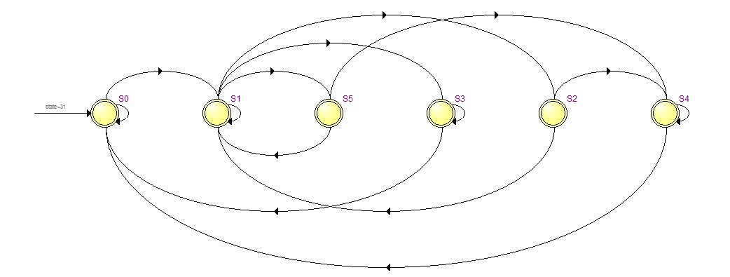
THEORY / BACKGROUND

Slide 6
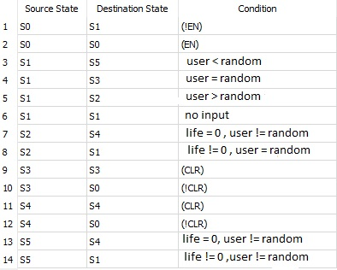

Slide 7
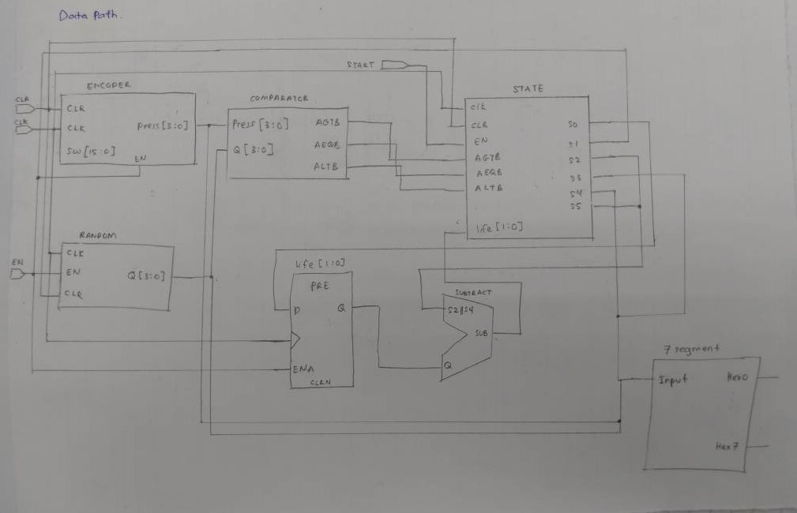
DATA PATH

Slide 8
EXPERIMENTAL RESULT
Able to run project as we planned.
The random number generated according to plan as we press the Push button, the random number starting to generate.
The number display on 7 segment follow the number of toggle switch which is on.
‘>’ symbol will be displayed when the number of the generated number is higher than the number that were chosen and symbol ‘<’ will be displayed if the situation is reverseable.
‘LOSE’ will be display when the user fail to guess while ‘WIN’ will be display if the user guess correctly.

Slide 9
CONCLUSION
We manage to apply the knowledge of Verilog coding throughout the semester to produce great and exciting games.
We want to show that using Verilog coding can also produce an interesting game to play.

